Slide 1

Serious Privacy Game Workshop

Slide 2
What is this?
This workshop is part of a master project at computer science at NTNU
As this is part of a master project some data will be collected:
Surveys before and after the workshop
Observations during the workshop
The ideas generated by the workshop group at the end of the workshop
Audio recording of presentation of game ideas
Photos of the group layout and of how you interact with the board.

Slide 3
Goal
To make a game that raises awareness about privacy while we think about privacy in groups.

Slide 4
Plan
Time | Activity | Varighet
12:30 | Introduction | 10 min
12:40 | Privacy and the internett | 10 min
12:50 | Game idea workshop | ~1.5t
~14:45 | Done
Notes:
Tentativ plan.
Har litt ekstra tid på slutten av dagen.

Slide 5
What is privacy?
Privacy means that everyone has the right to control what they share with others.
You should be able to have secrets.
Privacy also means that others are not allowed to share false rumors about you.
http://barneombudet.no/dine-rettigheter/til-a-vaere-meg/privatliv/

Slide 6
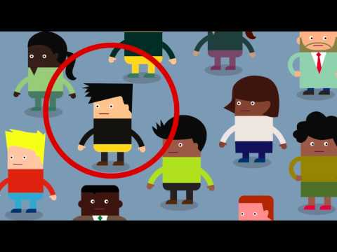

Slide 7


Slide 8
Privacy summary
Privacy
Privacy online
Why privacy matters
The tradeoffs

Slide 9

Serious Games
Notes:
Et spill som ikke har som hovedfokus å underholde - men å lære bort, endre en holdning, øke ferdigheter osv.
Selv om underholdning ikke er hovedfokuset er det et viktig virkemiddel ved serious games.
Vi fokuserer på 3 aspekter:
Reality - hva slags problem skal spillet løse?
Meaning - hva skal spillet gjøre deg bedre til? Endre holdninger? Trene deg i en krisesituasjon?
Play - hvordan kan dette gjøres til et morsomt spill som kan spilles igjen og igjen?

Slide 10
Goal
To make a game that raises awareness about privacy while we think about privacy in groups.

Slide 11
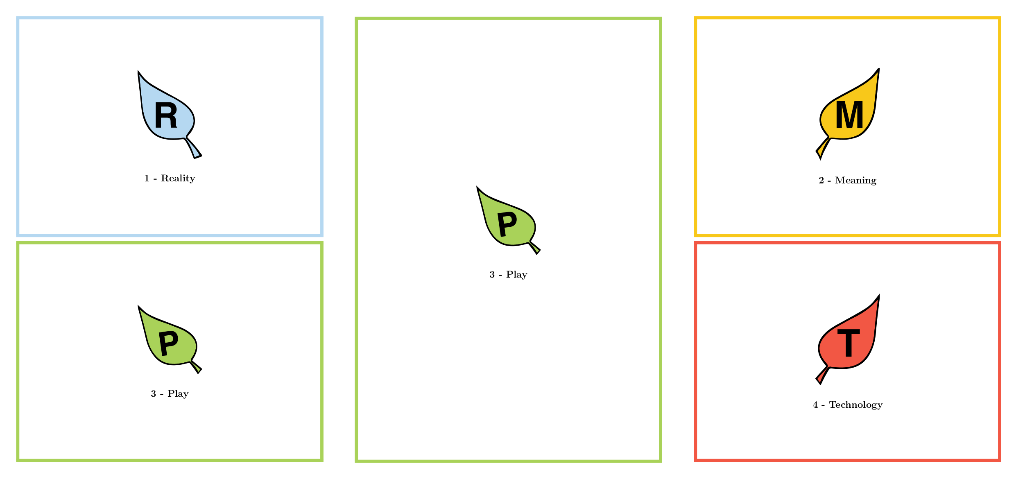

Workshop overview

Slide 12
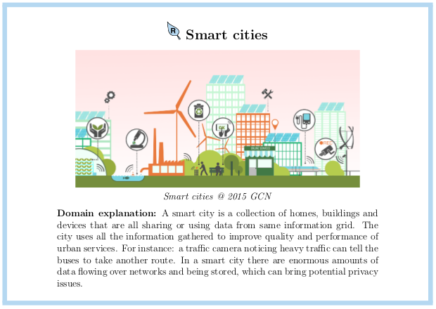

Slide 13
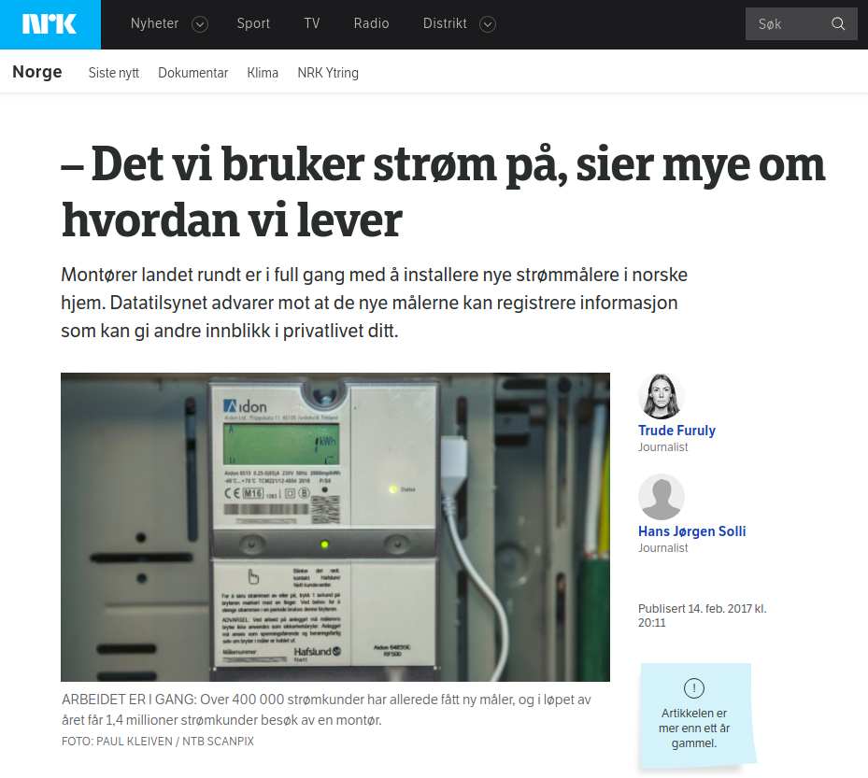
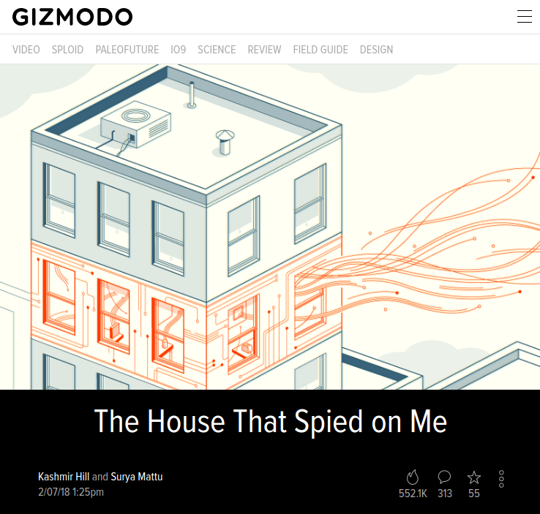
Notes:
Power
What we use power on tells a lot about how we live
Companies are buildt around analysing power usage and can interpret what appliances are used.
IOT and Internet Service Provider
More and more devices are connected to the internet
Hard to de the security right and often not enough benefit for the company
ISP listens to a lot of traffic and if it is not secure they get to know a lot about you.

Slide 14
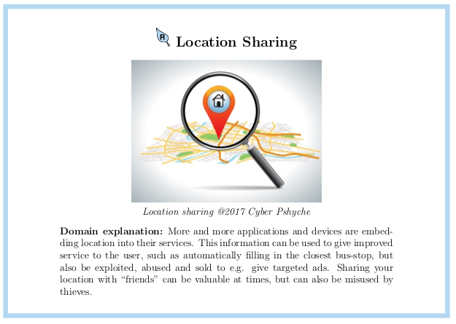

Slide 15
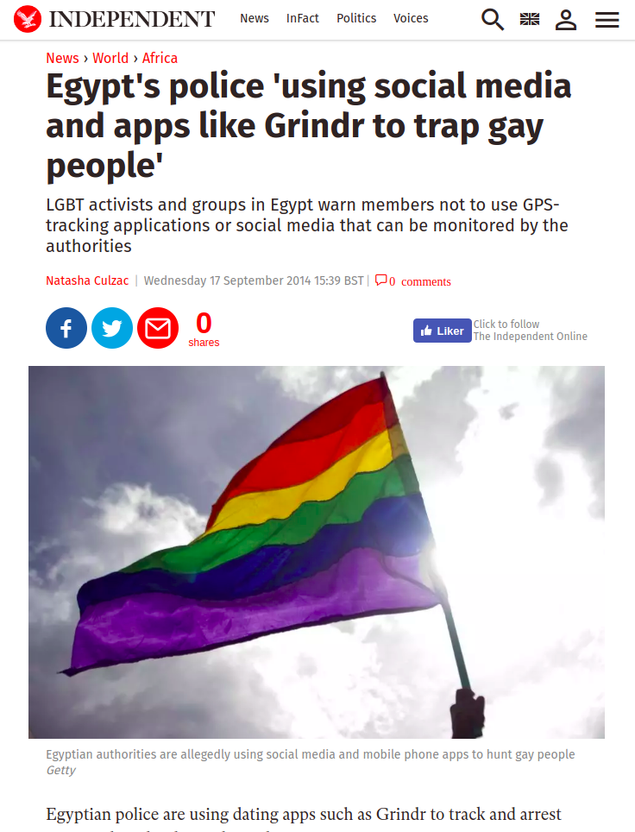
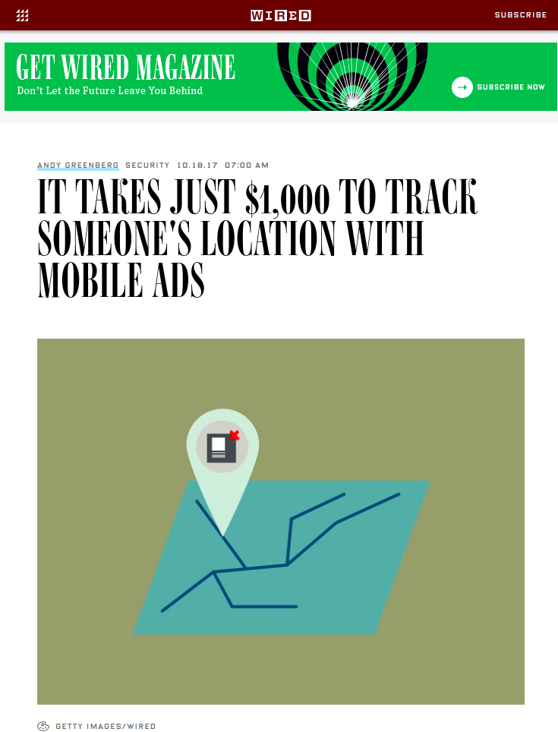
Notes:
ADS
By paying for a ad service a team of researches got to know the location of an individual
Grindr
App for gay allows for triangulating location

Slide 16
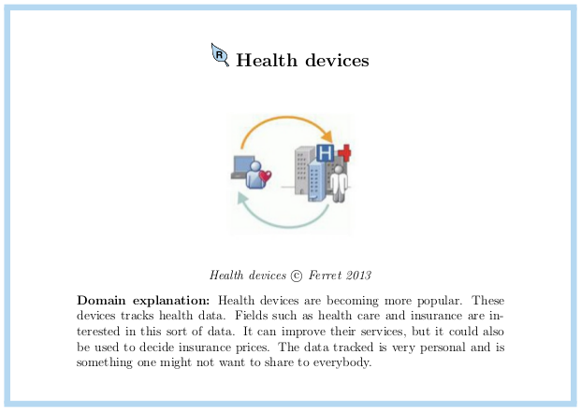

Slide 17
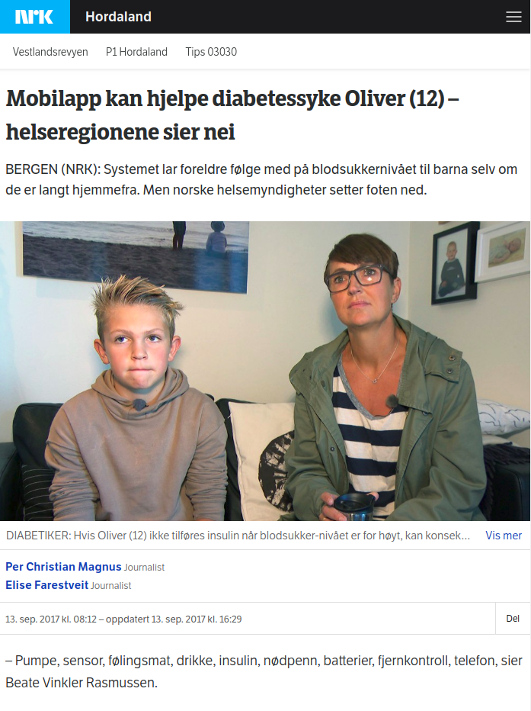
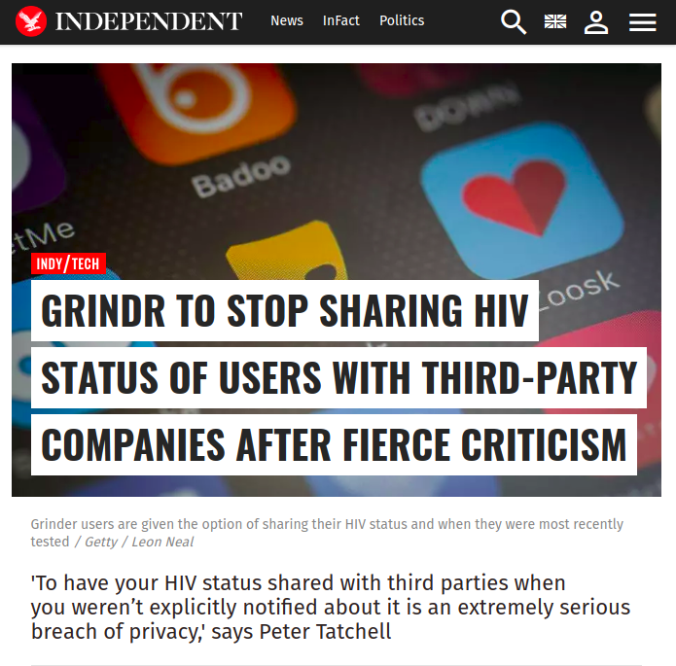

Slide 18
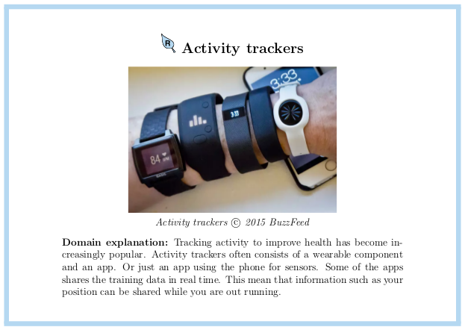

Slide 19
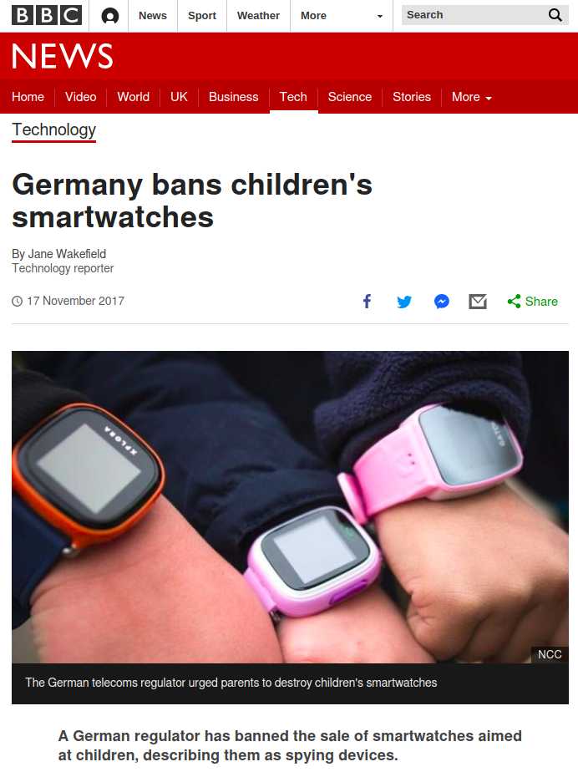
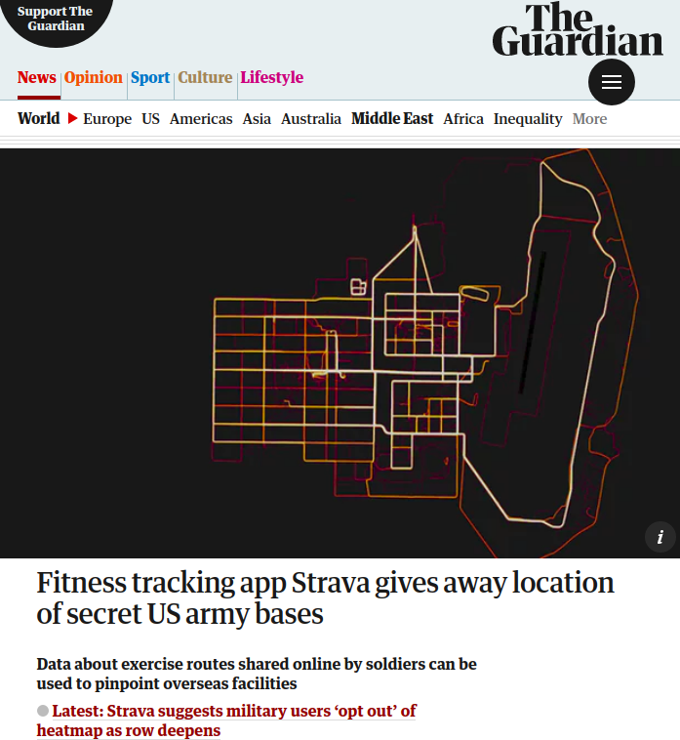
Notes:
Strava
However, over the weekend military analysts noticed that the map is also detailed enough that it potentially gives away extremely sensitive information about a subset of Strava users: military personnel on active service.
Smart watches
"Poorly secured smart devices often allow for privacy invasion. That is really concerning when it comes to kids' GPS tracking watches - the very watches that are supposed to help keep them safe," said Ken Munro, a security expert at Pen Test Partners.

Slide 20
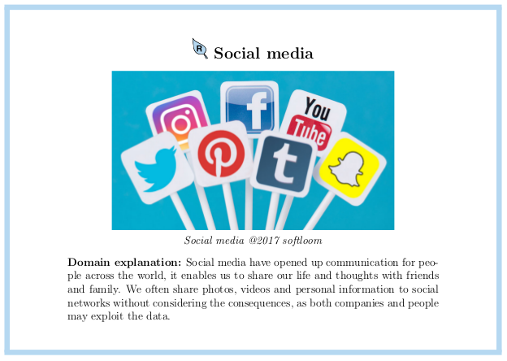

Slide 21
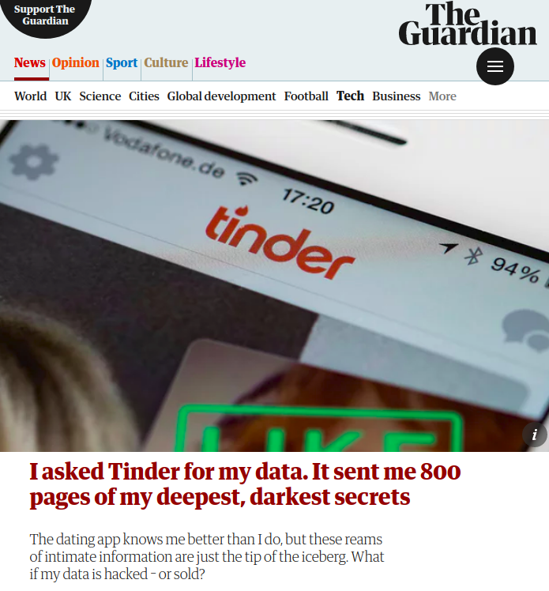
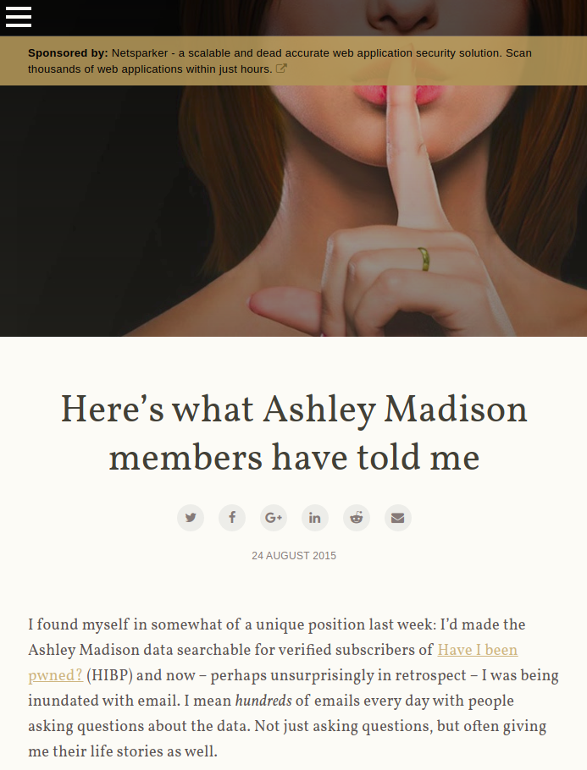
Notes:
Twitter, facebook, google
All have a lot of information
What you posted
What you looked at
Your location
Consequences
Dating site with sensitive information.
What they did does not matter. It’s their private personal information
People killed themselves

Slide 22
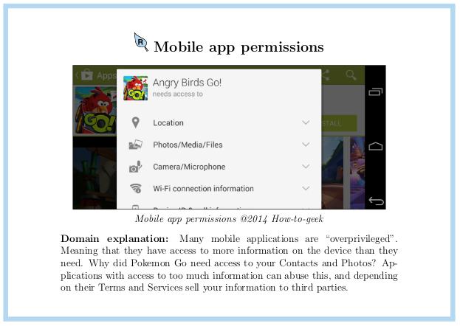

Slide 23
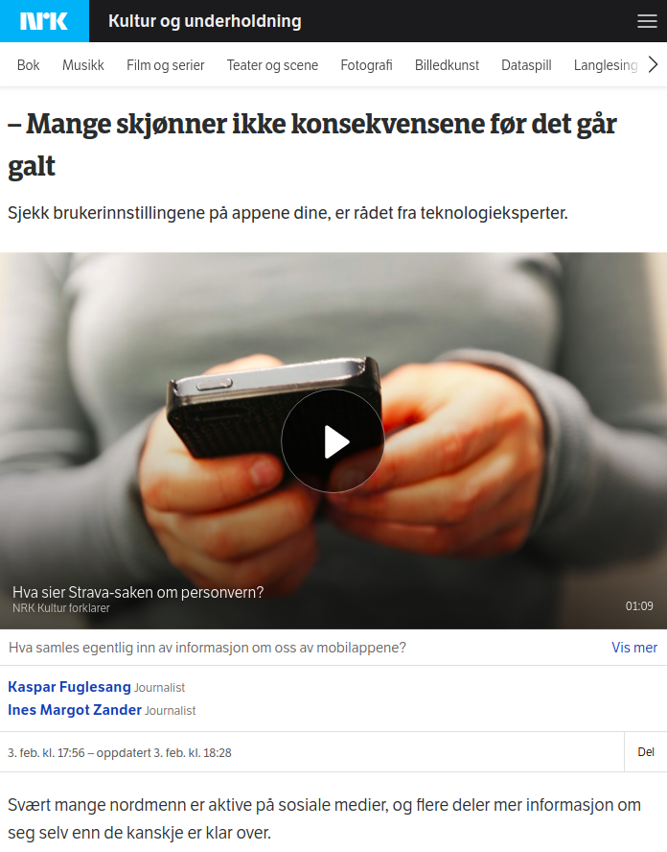
Notes:
You need to know what you are sharing
And what it is used for

Slide 24
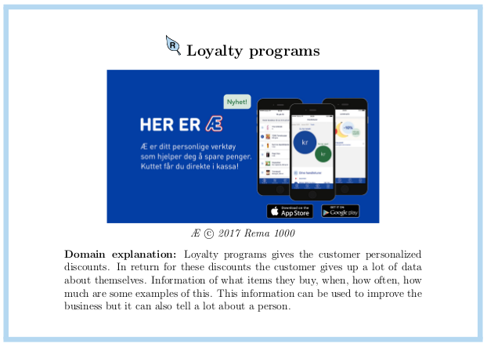

Slide 25
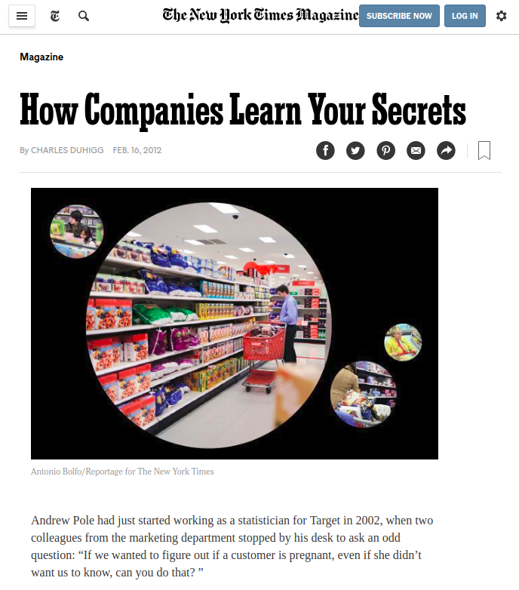

Slide 26
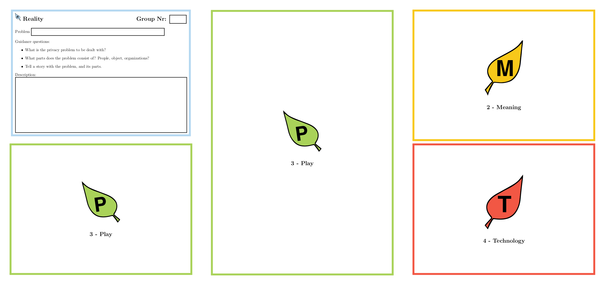
Reality: create a privacy problem

Slide 27
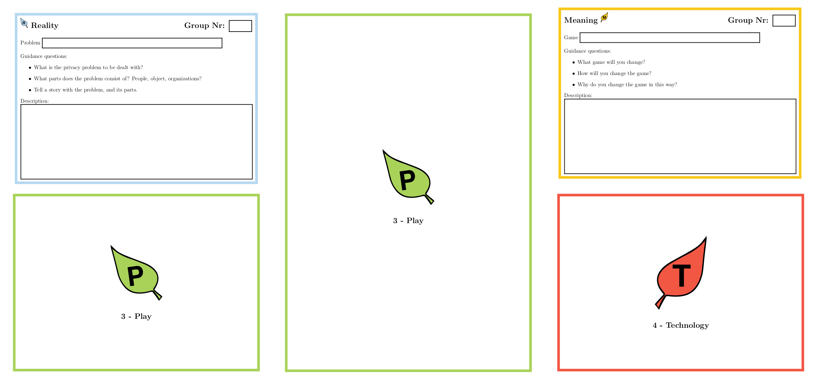
Meaning: increase awareness

Slide 28
Presentation 5 min notice
Remember:
What is your privacy problem?
What game have you selected?
How does these changes increase awareness of your privacy problem?

Slide 29

Meaning: increase awareness

Slide 30
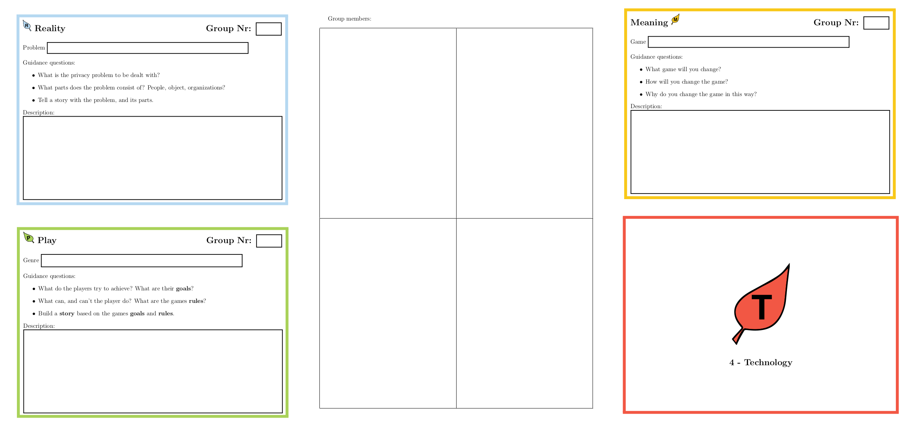
Play: create a game about your privacy problem

Slide 31
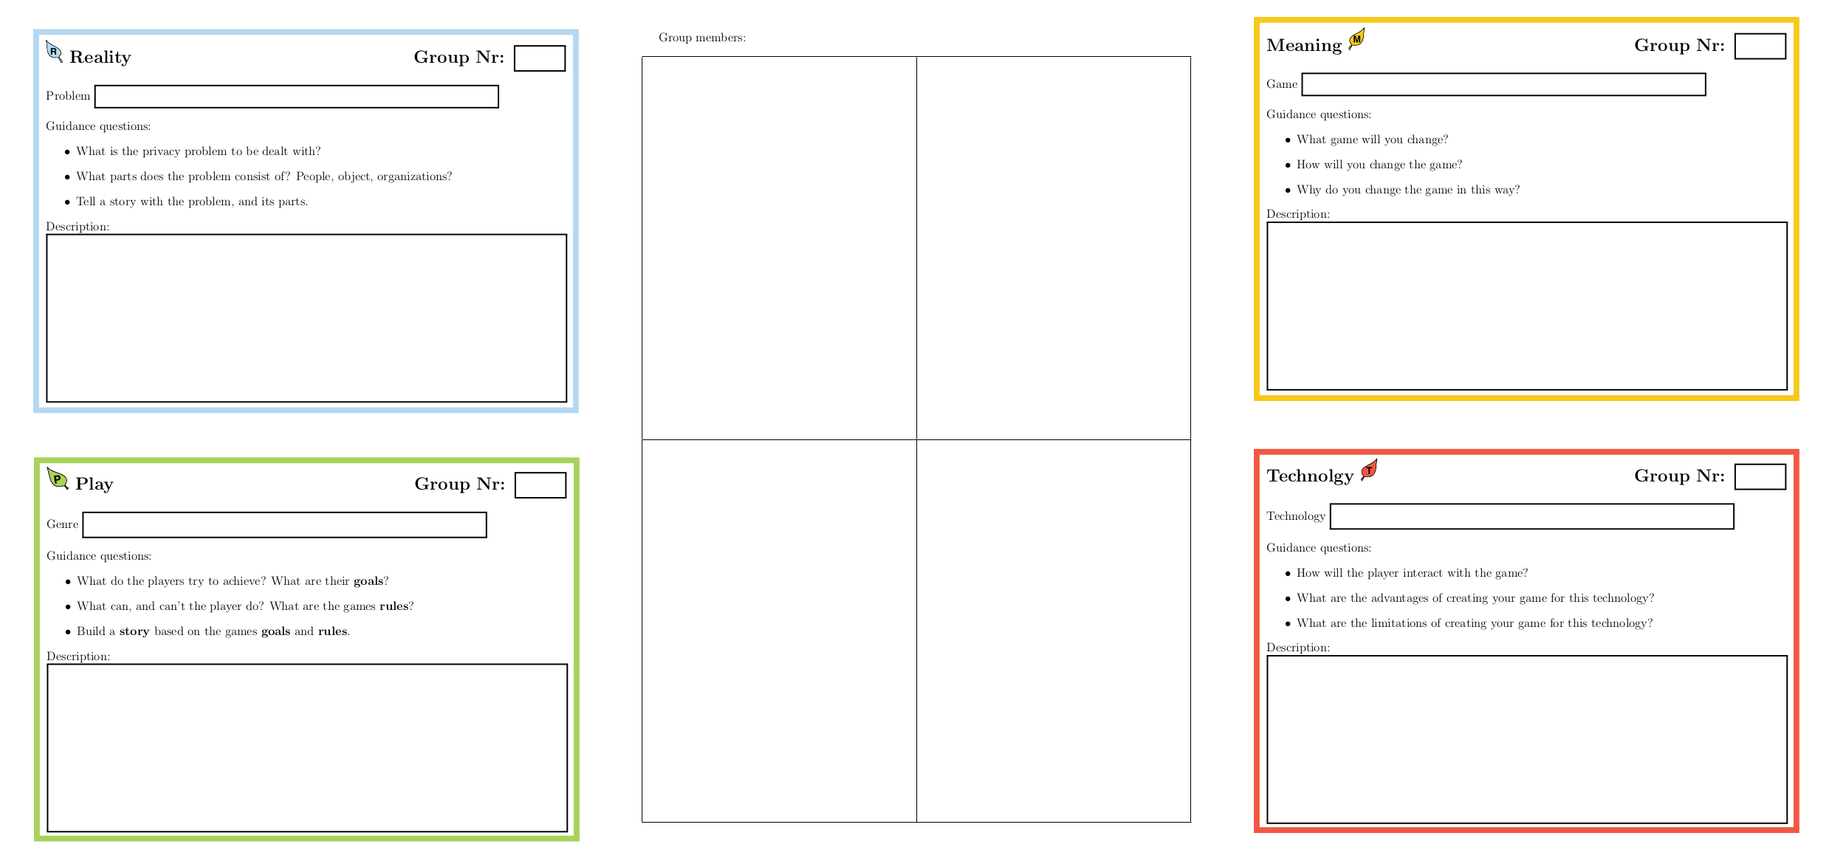
Technology: explain how your game is played

Slide 32
Presentation 5 min notice
Remember:
What is your game idea?
How is the game played?
How does the game increase awareness of your privacy problem?

Slide 33
5 min til presentasjon
Tape sammen delene

Slide 34
Technology: explain how your game is played

